Slide 1
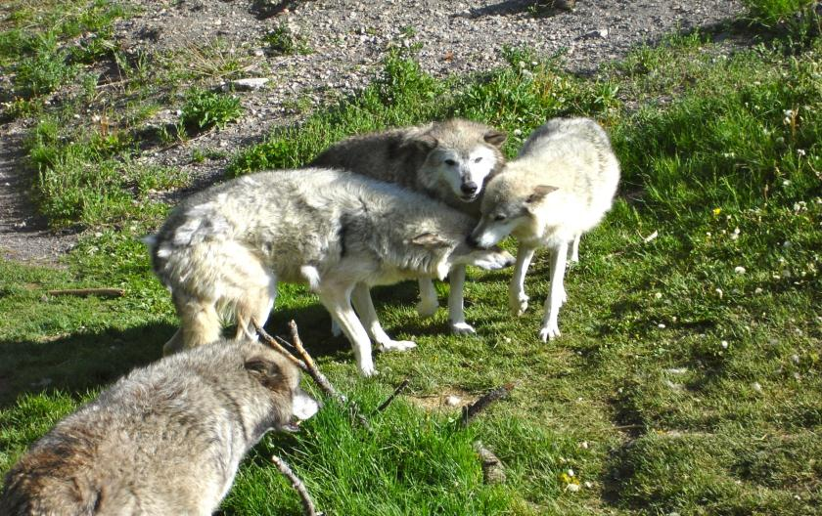
Wolves of Yellowstone National Park
“For the strength of the Pack is the Wolf, and the strength of the Wolf is the Pack.”
- The Law of the Jungle – Rudyard Kipling

Slide 2
Canis lupus
400 – 450 in Greater Yellowstone Ecosystem (about 100 in the park)
Highly social – live in packs of 8 -14 wolves with alpha male & females
90% of their winter prey is elk; 10–15% of their summer prey is deer (can kill bison)
Mate in February; give birth to average of five pups in April after a gestation period of 63 days; young emerge from den at 10–14 days; pack remains at the den for 3–10 weeks unless disturbed.

Slide 3
Canis lupus
In the 1800s westward expansion forced agriculture into lands dominated by wolves.
Many wolves were exterminated due to their potential as a predator of livestock.
Between 1914 – 1926, 136 wolves were killed in the park.
Debate still continues over their reintroduction to the park.

Slide 4
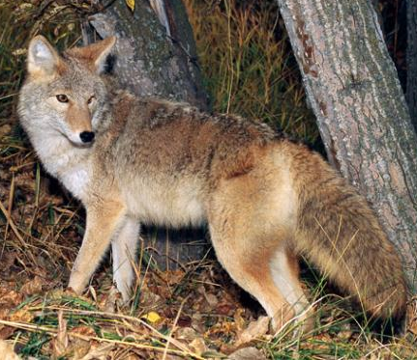
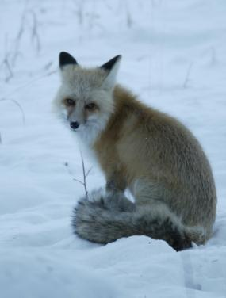
Notes:
Size comparison for the gray wolf, coyote, and fox 2008

Slide 5
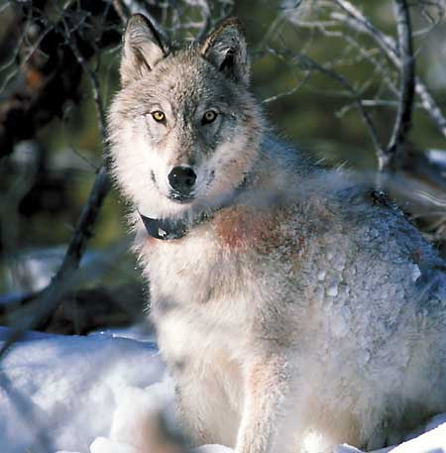
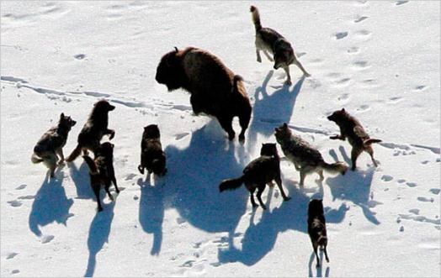
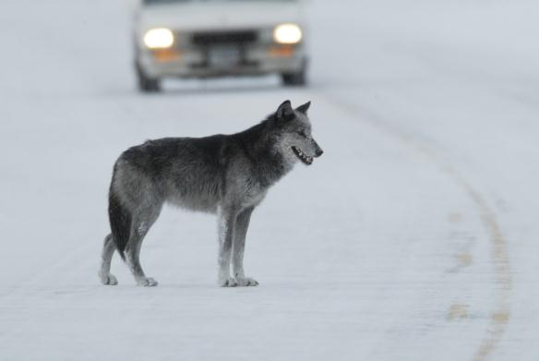
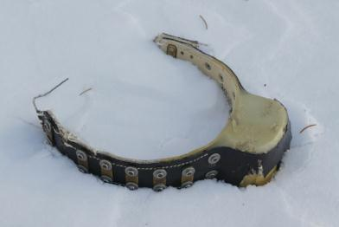
Gray Wolf
Notes:
Wolf reintroduction was one of the most controversial issues that Yellowstone and surrounding wildlands have experienced. The Gray Wolf was reintroduced by the National Park Service in conjunction with the US Fish and Wildlife Service about 1995. This introduction has been a great success, and today there are more than 400 wolves in over 50 distinct packs. Radio Tracking is used to locate each pack and high profile wolves. Wolves hunt in packs and can take down a bison, especially if it is ill or old. They also hunt elk, coyotes, and foxes, as well as other small game.

Slide 6
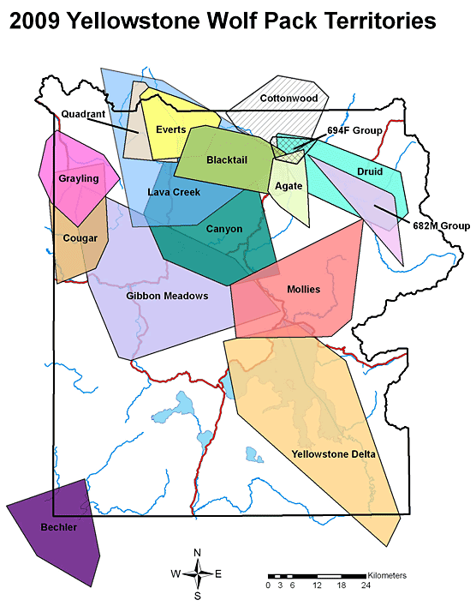
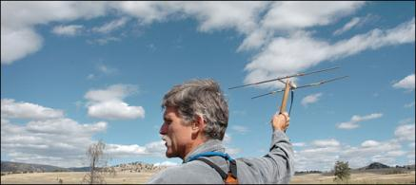
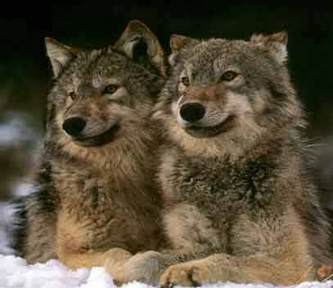
Notes:
Over 50 packs are followed by the NPS and USFWS staff, as well as other non service folks.

Slide 7
